Slide 1
Gluco Shape
Março 2026
Formação de produto
48973
Notes:
Welcome everyone to the product training of our latest Wellosophy addition – Gluco Shape.
Today I want us to learn the features, but also experience the product with all our senses, so we can confidently recommend it to others.

Slide 2

Sentes que estás sempre a lutar contra o apetite… e a perder?
Petiscas mesmo quando nem tens fome?
Acabas por comer mais do que tinhas planeado?
5 em 10 adultos passam por isto
Notes:
I want to start by asking you:
Do you ever feel like you’re fighting your appetite… and losing?
Snacking when you’re not even hungry?
Or eating more than you planned?
You’re not alone!
[CLICK] Nearly 5 in 10 adults with overweight or obesity struggle with emotional eating, and snacking when they’re not hungry or eating more than planned.¹
Reference:
Chew HSJ, Soong RY, Ang WHD, Ngooi JW, Park J, Yong JQYO, Goh YSS. The global prevalence of emotional eating in overweight and obese populations: A systematic review and meta-analysis. Br J Psychol. 2025 May;116(2):484-498. doi: 10.1111/bjop.12768. Epub 2025 Jan 15. PMID: 39815661; PMCID: PMC11984340.

Slide 3

Uma crise global de peso em crescimento
4 em 10
adultos tem excesso de peso ou obesidade
Notes:
And in connection to this, the biggest threat to public health nowadays is the global epidemic of overweight and obesity.
In 2022, around 2.5 billion adults worldwide were overweight, including more than 890 million living with obesity.
This represents roughly 4 in 10 adults worldwide, up from 1 in 4 in 1990.¹
This is why weight and metabolic health matters more than ever!
Reference:
NCD Risk Factor Collaboration. Worldwide trends in underweight and obesity from 1990 to 2022: a pooled analysis of 3663 population-representative studies with 222 million children, adolescents, and adults. The Lancet 2024. 16;403(10431):1027-1050. doi: 10.1016/S0140-6736(23)02750-2

Slide 4
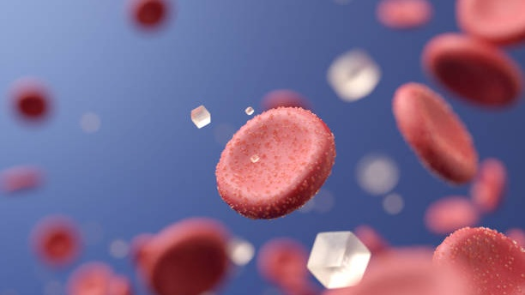
Maior procura por soluções para o metabolismo e os níveis de açúcar no sangue
Equilíbrio dos níveis de açúcar no sangue
Alternativas naturais
Gestão de peso
Beleza de dentro para fora
Energia
Bem-estar metabólico
Embalagem prática
Notes:
That’s probably the reason why global consumers are increasingly seeking the right support for blood sugar balance, weight management, and energy.
[CLICK] Growing GLP-1 awareness is driving interest in natural alternatives, while social media fuels demand for beauty-from-within and metabolic wellness.
[CLICK] People want the solution to be conveniently packed and preferably in a functional powder stick format, as it’s perceived as premium and fit seamlessly into a modern health and beauty routine.¹
Reference:
Euromonitor international. 2025-11-26. https://www.euromonitor.com/article/top-trends-shaping-the-health-and-wellness-industry

Slide 5

Imagina-te daqui a algumas semanas, com mais controlo, com menos fome entre as refeições e confiante nas tuas escolhas
Notes:
With this in mind, now imagine yourself a few weeks from now – being in control, satisfied after meals, and confident in your choices.
How would that make you feel?
Quite good, right?!

Slide 6

Temos o que necessitas!
Ajuda-te no controlo de peso
Notes:
Wellosophy has exactly the solution you need!
Let me introduce Gluco Shape – a new product designed to steady blood glucose, support metabolism and help you stay on track with your weight-loss goals.

Slide 7

Unboxing
Notes:
Let’s unbox it together and see what’s inside – from the packaging to the powerful formula.

Slide 8
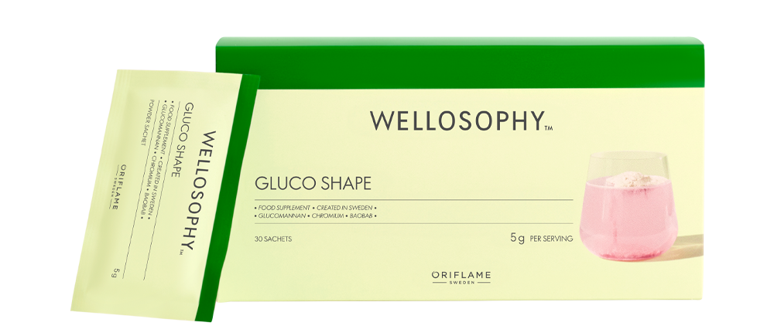



Embalagem
30
sachets per pack
Práticas doses individuais fáceis de transportar.
O material garante proteção ideal, frescura e prazo de validade otimizados.
Notes:
The outer carton is FSC-certified, meaning it comes from environmentally, socially, and economically responsible sources. This reflects our commitment to sustainability.
[CLICK] The box comes with 30 single-serve sachets that are designed for maximum convenience, making them easy to take to work, the gym, or on holiday.
[CLICK] In addition, the high-barrier laminate material, combining aluminium and plastic, ensures optimal protection, freshness, and shelf life of the product.

Slide 9
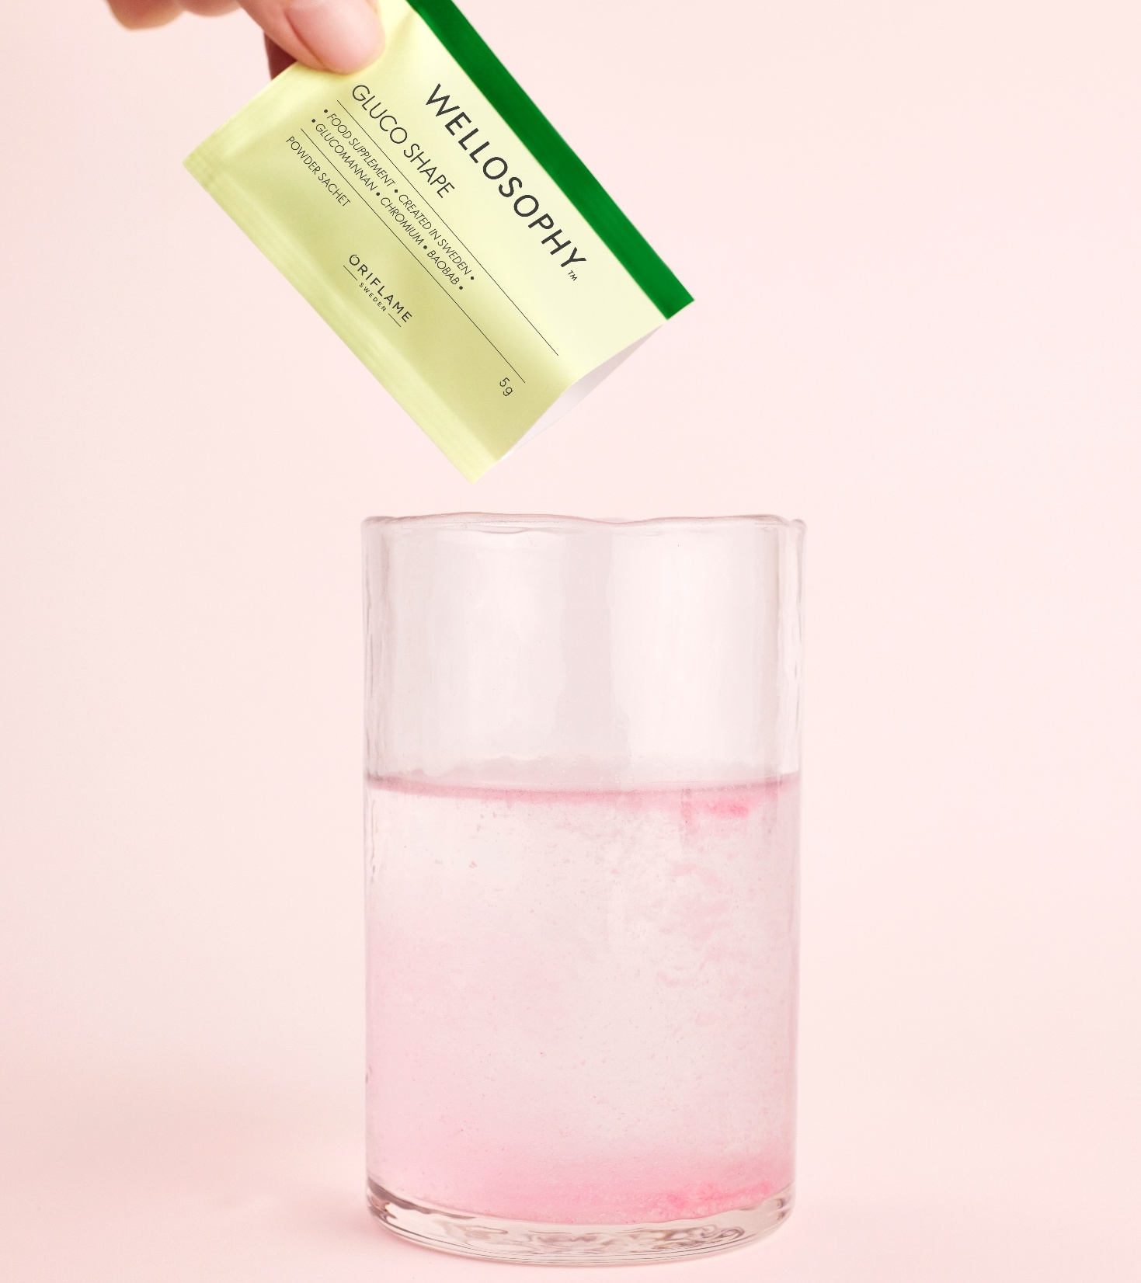

Mistura o produto
1 saqueta
Bebe e desfruta até
3x por dia,
30 minutos antes das principais refeições
200 ml de água
Mexe
Apenas para adultos (18+). Não indicado para crianças, grávidas ou mulheres a amamentar. Não exceder a dose diária recomendada.
Os suplementos alimentares não devem ser utilizados como substitutos de uma alimentação equilibrada e variada.
Notes:
Now, let’s take one sachet of powder (5 g) and pour it into 200 ml of water, and stir.
[CLICK] Once mixed, it should be enjoyed immediately up to 3 times daily, 30 minutes before a meal.
[CLICK] It’s for adults only and not for children, pregnant or breastfeeding women.
Do not exceed the recommended daily dose.

Slide 10




Usa os teus sentidos
VÊ
CHEIRA
PROVA
TOCA
Notes:
Now, I’d like us to experience Gluco Shape with all our senses.
[CLICK] First, look at it. That bright pink colour – doesn’t it instantly make you want to take a sip?
[CLICK] Now close your eyes, bring the glass closer, and take a deep breath through your nose.
Can you almost picture fresh raspberries in your head?
[CLICK] Let’s take a sip and taste it.
Let the raspberry flavour spread across your palate.
[CLICK] Next is touch – the texture in your mouth, also called mouthfeel.
It’s a key part of how we experience food and drinks.
Notice how it feels. Does it feel watery, smooth, rich or maybe tingly?
And now, don’t finish the whole glass just yet.
Save some for later – I’ll explain why in a moment.

Slide 11
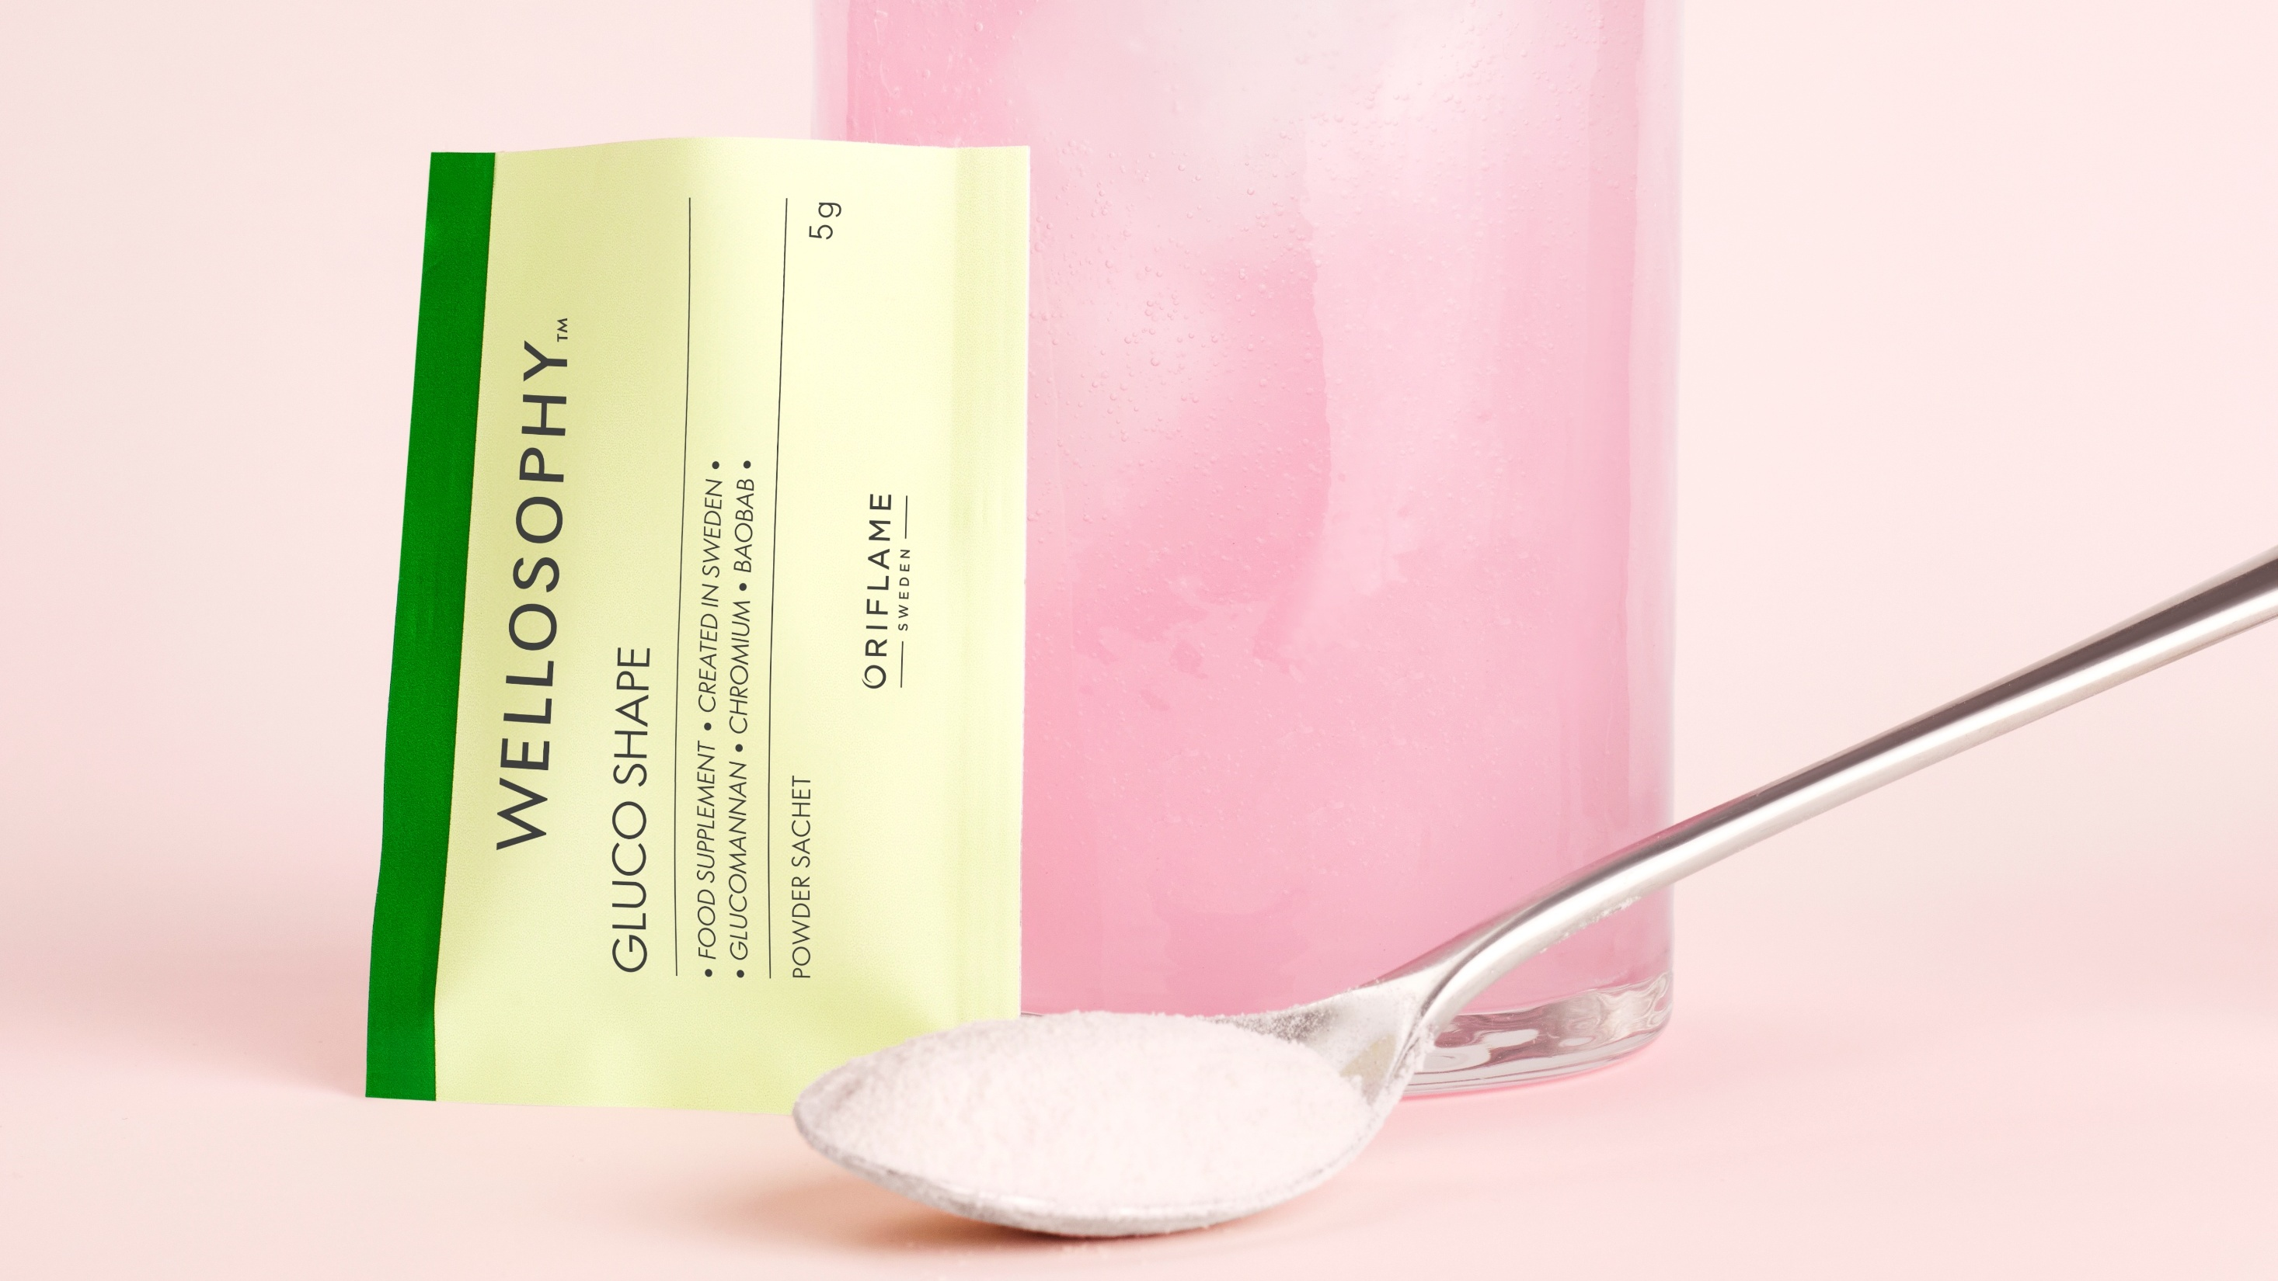

O que contém?
Glucomannan
Chromium
Baobab
Raspberry flavour
Notes:
So what does it contain?
It’s a raspberry flavoured powder containing the key ingredients [CLICK] glucomannan and chromium, supported by baobab.
Let’s take a short deep dive into these ingredients!

Slide 12


Glucomanano
Absorve 50x
o seu peso
Da raiz de konjac.
Fibra natural solúvel em água
Fibra altamente absorvente, que forma uma substância semelhante a gel no estômago
Análise detalhada dos ingredientes
Baixo em calorias
Apoia;
controlo de peso
controlo dos níveis de açúcar no sangue
colesterol
saúde digestiva
Should be taken with adequate fluids | May cause initial mild bloating or gas
Notes:
Let’s start with glucomannan!
[CLICK] It’s a natural, water-soluble dietary fibre extracted from the root of the konjac plant (Amorphophallus konjac).
[CLICK] Glucomannan is a highly absorbent fibre that can absorb up to 50 times its weight in water, forming a gel-like substance in the stomach.
[CLICK] As it’s mostly fibre, it’s low in calories.
[CLICK] Many clinical studies have been done on this fibre and it’s gained attention for its role in weight management, blood sugar control, cholesterol and digestive health.
1. Weight Management ¹⁻⁴
Expands in the stomach, increasing feelings of fullness
Helps reduce appetite and calorie intake
Approved in the EU for weight-loss claims when used with a calorie-restricted diet
2. Blood Sugar Control ⁵
Slows carbohydrate absorption
Helps stabilize post-meal blood glucose levels
Beneficial for people managing insulin sensitivity
3. Cholesterol & Heart Health ²
Can help lower LDL (“bad”) cholesterol
Supports overall cardiovascular health
4. Digestive Health ⁶
Improves bowel regularity
Helps prevent constipation
Supports gut microbiome balance, as it’s known for its prebiotic properties – serving as food for beneficial gut bacteria.
[CLICK] It’s important to take it with enough water to avoid the risk of choking or blockage.
For people who aren’t used to a high-fibre intake, it may also cause mild bloating or gas at first, but this usually settles as the body adapts.
References:
Walsh DE, Yaghoubian V, Behforooz A. Effect of glucomannan on obese patients: a clinical study. Int J Obes. 1984;8(4):289-93. PMID: 6096282.
Sood N, Baker WL, Coleman CI. Effect of glucomannan on plasma lipid and glucose concentrations, body weight, and blood pressure: systematic review and meta-analysis. Am J Clin Nutr. 2008 Oct;88(4):1167-75. doi: 10.1093/ajcn/88.4.1167. PMID: 18842808.
Guo L, Yokoyama W, Chen M, et al. Konjac glucomannan molecular and rheological properties that delay gastric emptying and improve the regulation of appetite. Food Hydrocoll. 2021;120:106894. doi: 10.1016/j. foodhyd.2021.106894.
EFSA Panel on Dietetic Products, Nutrition and Allergies (NDA); Scientific Opinion on the substantiation of health claims related to konjac mannan (glucomannan) and reduction of body weight (ID 854, 1556, 3725), reduction of post-prandial glycaemic responses (ID 1559), maintenance of normal blood glucose concentrations (ID 835, 3724), maintenance of normal (fasting) blood concentrations of triglycerides (ID 3217), maintenance of normal blood cholesterol concentrations (ID 3100, 3217), maintenance of normal bowel function (ID 834, 1557, 3901) and decreasing potentially pathogenic intestinal microorganisms (ID 1558) pursuant to Article 13(1) of Regulation (EC) No 1924/2006. EFSA Journal. 2010;8(10):1798. [27 pp.]. doi: 10.2903/j.efsa.2010.1798. Available online: www.efsa.europa.eu/efsajournal.htm
Mirzababaei A, Zandkarimi R, Moradi S, Rasaei N, Amini MR, Pourreza S, Abaj F, Clark CCT, Daneshzad E, Mirzaei K. The effect of Glucomannan on fasting and postprandial blood glucose in adults: a systematic review and meta-analysis of randomized controlled trials. J Diabetes Metab Disord. 2022 Feb 27;21(1):1055-1063. doi: 10.1007/s40200-022-00993-6. PMID: 35673426; PMCID: PMC9167156.
Zhu Y, Chen X, Song G. Effects of konjac glucomannan on gastrointestinal symptoms and gut microbiota in athletes with functional constipation: a double-blind randomized controlled trial. Eur J Nutr. 2025 Oct 21;64(8):303. doi: 10.1007/s00394-025-03826-3. PMID: 41117955.

Slide 13
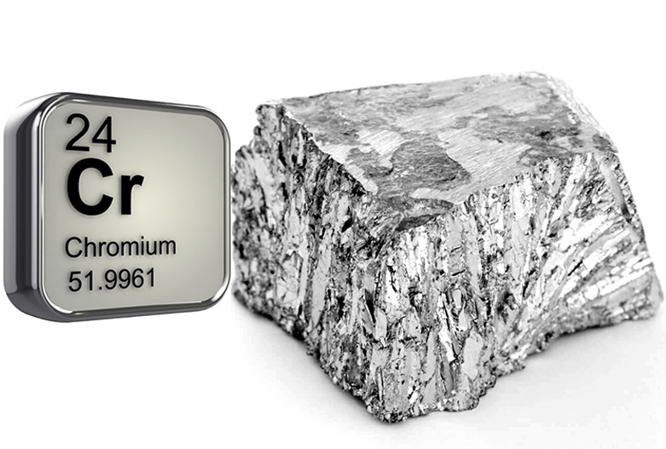

Crómio
Oligoelementos essenciais
Análise detalhada dos ingredientes
Melhora a ação da insulina
Forma mais comum e com maior biodisponibilidade, picolinato de crómio.
Apoia o controlo dos níveis de açúcar no sangue e o metabolismo energético
Notes:
Chromium is an essential trace mineral that plays an important role in metabolism, and overall nutrient balance. ¹
[CLICK] It’s known that chromium helps enhance the action of insulin, the hormone responsible for moving glucose from the bloodstream into cells for energy.
Because of this, it is closely linked to blood sugar regulation and metabolic health.
[CLICK] Research suggests chromium supplementation may modestly improve blood sugar control, especially in people with type 2 diabetes or insulin resistance, though results vary between studies.
1. Blood Sugar Control ^{1, 2, 3}
Improves insulin sensitivity
Helps maintain stable blood glucose levels, reducing the ups and downs that may otherwise lead to cravings
Particularly relevant for people with insulin resistance or impaired glucose tolerance
2. Energy Metabolism ³
Supports normal carbohydrate, fat, and protein metabolism
By that, helps convert food into usable energy
Supports overall metabolic efficiency
[CLICK] There are several forms of chromium. The most researched and commonly used form in supplements is chromium picolinate, which is generally considered the most bioavailable form as well.
References:
Dubey P, Thakur V, Chattopadhyay M. Role of Minerals and Trace Elements in Diabetes and Insulin Resistance. Nutrients. 2020 Jun 23;12(6):1864. doi: 10.3390/nu12061864.
Monfared V, Rashin H, Malekinejad S, Sheikhi L, Yousefi M, Vakili MA, Hasani M. The effect of chromium supplementation on cardio-metabolic risk factors in overweight and obese patients. A systematic review and meta-analysis of randomized controlled trial. J Trace Elem Med Biol. 2025 Jun;89:127645. doi: 10.1016/j.jtemb.2025.127645. Epub 2025 Apr 12. PMID: 40245649.
EFSA Panel on Dietetic Products, Nutrition and Allergies (NDA); Scientific Opinion on the substantiation of health claims related to chromium and contribution to normal macronutrient metabolism (ID 260, 401, 4665, 4666, 4667), maintenance of normal blood glucose concentrations (ID 262, 4667), contribution to the maintenance or achievement of a normal body weight (ID 339, 4665, 4666), and reduction of tiredness and fatigue (ID 261) pursuant to Article 13(1) of Regulation (EC) No 1924/2006. EFSA Journal. 2010;8(10):1732. [23 pp.]. doi:10.2903/j.efsa.2010.1732. Available online: www.efsa.europa.eu/efsajournal.htm

Slide 14
Quebras a meio da tarde.
Sono depois do almoço.
Desejos repentinos por doces.
Soa familiar?
Notes:
Do you ever feel an energy crash in the afternoon?
That heavy, sleepy feeling after lunch?
Or suddenly feel hungry again just a couple of hours after eating?
That’s often linked to your blood sugar curve.

Slide 15

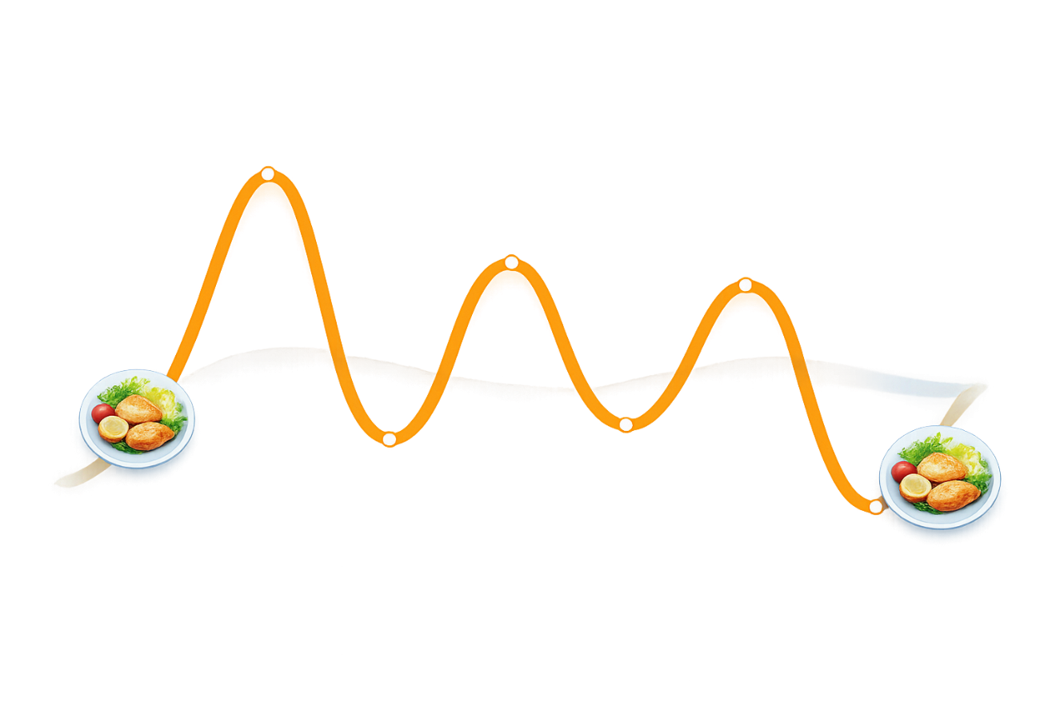

Sabias que?
“
Picos acentuados de açúcar no sangue costumam ser seguidos por quebras que aumentam a fome e os desejos.
Níveis de açúcar no sangue mais estáveis ajudam a manter a energia, a clareza mental e um melhor controlo do apetite.
Faz refeições equilibradas com alimentos ricos em fibra para evitar grandes oscilações nos níveis de açúcar no sangue!
Marlene Nordlander
MSc, Reg. Dietitian
Notes:
So, why is it good to have a steady blood sugar?
CLICK] Well, big ups and downs in blood sugar can affect how hungry you feel.
After a meal, a sharp rise in blood sugar is often followed by a quick drop – and that drop can trigger cravings and make you want to eat again sooner.
CLICK] When blood sugar stays more balanced, energy levels are steadier, the mind feels clearer, and appetite is easier to manage.
It’s not about keeping blood sugar ‘flat’ – it’s about avoiding extreme swings.
[CLICK] That you can do by eating balanced meals with high-fibre foods such as wholegrains, fruits and vegetables to slow stomach emptying.
And now you can support it with glucomannan fibre and chromium as well!
In depth explanation:
After eating, glucose from carbohydrates enters the bloodstream, causing a temporary rise (“spike”) in blood glucose levels. ¹
Insulin is released to help cells absorb this glucose, lowering blood glucose levels (“dip”) as glucose is cleared from the blood. ¹
Pronounced glucose spikes and subsequent rapid dips are linked to increased hunger and higher energy intake. ²
And the larger the glucose spike, the larger the following glucose dip. ²
Research shows that larger postprandial glucose dips 2–3 hours after a meal predict greater hunger, shorter time to next meal and higher subsequent energy intake. ²
Glucose dips are just one aspect of why we eat as there are numerous other social, psychological and physiological factor that greatly influence appetite regulation. ²
Excess weight impairs the regulation of blood glucose and increases the risk of insulin resistance, oxidative stress and metabolic diseases such as type 2 diabetes. ³
For healthy individuals, glucose fluctuations within the normal range are expected. ⁴
There is currently no evidence that striving for an almost flat glucose profile is necessary or beneficial in non-diabetic individuals. ⁴
References:
Shaheen A, Sadiya A, Mussa BM, Abusnana S. Postprandial Glucose and Insulin Response to Meal Sequence Among Healthy UAE Adults: A Randomized Controlled Crossover Trial. Diabetes Metab Syndr Obes. 2024 Nov 14;17:4257-65. doi: 10.2147/DMSO.S468628.
Wyatt P, Berry SE, Finlayson G, et al. Postprandial glycaemic dips predict appetite and energy intake in healthy individuals. Nat Metab. 2021 Apr;3(4):523-9. doi: 10.1038/s42255-021-00383-x.
Atella V, Belotti F, Giaccherini M, et al. The interplay between excess weight and hyper-glycemia on NCDs in Italy: results from a cross-sectional study. Acta Diabetol. 2024 Sep;61(9):1129-42. doi: 10.1007/s00592-024-02296-z.
Spartano NL, Sultana N, Lin Het al. Defining Continuous Glucose Monitor Time in Range in a Large, Community-Based Cohort Without Diabetes. J Clin Endocrinol Metab. 2025 Mar 17;110(4):1128-34. doi: 10.1210/clinem/dgae626.

Slide 16
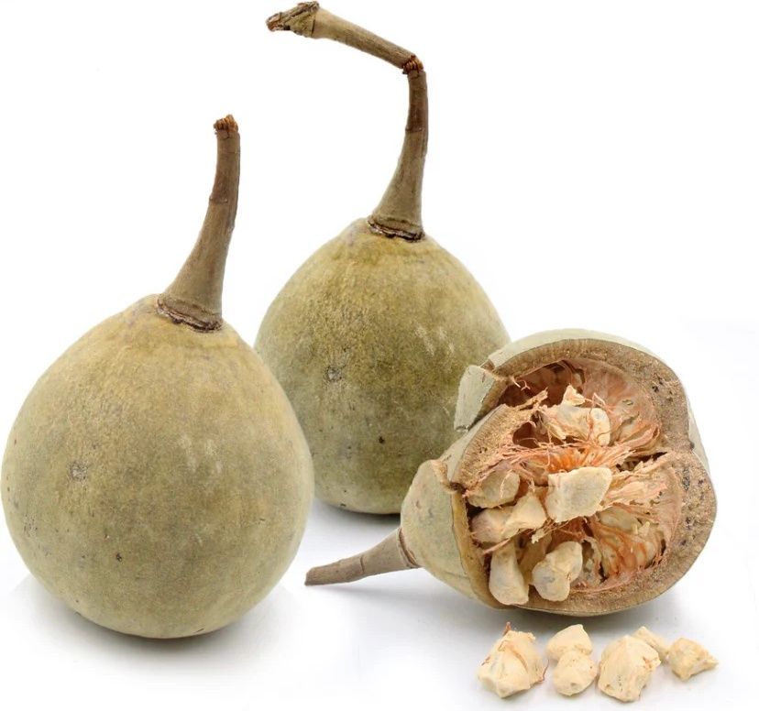

Baobab
“Superfruto de África” que cresce no Embondeiro, a “Árvore da Vida”
Ingrediente de “beleza de dentro para fora” com vitamina C, polifenóis e antioxidantes
SABIAS QUE?
Contém até 6 vezes mais vitamina C do que a laranja
Análise detalhada dos ingredientes
50% do fruto é fibra, rico em fibra prebiótica
Seco ao sol pela natureza para preservar naturalmente os nutrientes
Notes:
Now going back to the ingredient deep dive.
Baobab fruit powder is a supportive ingredient in the Gluco Shape formulation.
The baobab fruit is known as a superfruit from Africa, and grows on the baobab tree – recognised as the “tree of life” as it can live for over 1,000 years and store huge amounts of water in their trunks. In many African cultures, they symbolise resilience, longevity, and nourishment.
[CLICK] Unlike most fruits, baobab dries naturally inside its shell while still on the tree.
This means no artificial drying, no added preservatives, and nutrients are naturally preserved.
This makes it a nutrient-rich fruit known for its beneficial nutrients. ¹
[CLICK] For instance, it’s a natural source of vitamin C, polyphenols, and antioxidants – thereby known as a “beauty from within ingredient”
[CLICK] Did you know for instance that it contains up to 6x more vitamin C than oranges?!
[CLICK] Additionally, it contains around 50% fibre, especially prebiotic fibre!
Reference:
Silva ML, Rita K, Bernardo MA, et al. Adansonia digitata L. (Baobab) Bioactive Compounds, Biological Activities, and the Potential Effect on Glycemia: A Narrative Review. Nutrients. 2023 May 1;15(9):2170. doi: 10.3390/nu15092170.

Slide 17

Informação nutricional e ingredientes
Informação nutricional | Por cada 5 g
Glucomanano | 1 g
Crómio | 12 μg (30%*)
Baobab | 150 mg
Informação nutricional | Por 100 g | Por cada 5 g
Energia kJ | 862 kJ | 43 kJ
Energia Kcal | 212 kcal | 11 kcal
Gorduras g | 0.1 | 0
das quais saturadas g | 0 | 0
Hidratos de carbono g | 12.9 | 0.6
dos quais açúcares g | 1.5 | 0.1
Fibras g | 79 | 4.0
Proteína g | 0.4 | 0
Sal g | 0.03 | 0
*VRN = Valor de Referência Nutricional
μg = microgramas
Ingredientes:
Dextrina resistente, Glucomanano derivado do extrato de konjac (tubérculo) (Amorphophallus konjac) (mínimo de 20 %), Pó de baobá (fruto) (Adansonia digitata) (0,3 %), Regulador de acidez (ácido cítrico), Aromatizante natural, Concentrado de sumo de beterraba vermelha (Beta vulgaris L.), Edulcorante (sucralose), Crómio (picolinato de crómio (III)).
Notes:
Now look how much of the ingredients there are in Gluco Shape.
It contains 1 g glucomannan, 12 micrograms of chromium picolinate (the most bioavailable form) – which corresponds to 30% of EU Nutrient Reference Value – and 150 mg of baobab fruit powder per serving.
To the right, you can also see the nutritionals, showing that it only contains 11 calories per serving, coming mainly from fibres.
And below the nutritionals you can view the full ingredient list.

Slide 18






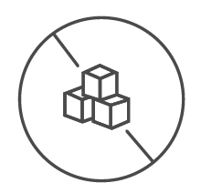


Benefícios
ALEGAÇÕES DE SAÚDE
Glucomanano
O glucomanano, no contexto de uma dieta com restrição energética, contribui para a perda de peso.*
Crómio
O crómio contribui para o normal metabolismo dos macronutrientes.
O crómio contribui para a manutenção de níveis normais de glicose no sangue.
Formulado para ajudar a estabilizar a glicose, apoiar o metabolismo e ajudar-te a manter o foco nos teus objetivos de perda de peso.
Não-GOGM
Sem aromatizantes artificiais
Sem conservantes artificiais
Sem adição de açúcar
Adequado para vegetarianos
Sem corantes artificiais
À base de plantas
* O efeito benéfico é obtido com uma ingestão diária de 3 g de glucomanano, repartida por três doses de 1 g cada, acompanhadas de 1 a 2 copos de água, antes das refeições e no âmbito de uma dieta hipocalórica.
Notes:
So, what kind of benefits can we actually claim on a product level?
Well, with the ingredients we’ve selected for this product, [CLICK] it’s designed to steady glucose, support metabolism and help you stay on track with your weight-loss goals.
We have several EU approved health claims [CLICK] :
“Glucomannan in the context of an energy restricted diet contributes to weight loss”¹
The beneficial effect is obtained with a daily intake of 3 g of glucomannan in three doses of 1 g each, together with 1-2 glasses of water, before meals and in the context of an energy-restricted diet.
“Chromium contributes to normal macronutrient metabolism” ²
“Chromium contributes to the maintenance of normal blood glucose levels”²
Baobab does not have any EU health claims and is therefore a supportive ingredient, adding valuable phytonutrients to our daily diet.
We’re proud of the formulation as it’s [CLICK] :
Non-GMO
No artificial preservatives, colours, flavours
No added sugar
Plant-based – [CLICK] thereby suitable for vegetarians
References:
EFSA Panel on Dietetic Products, Nutrition and Allergies (NDA); Scientific Opinion on the substantiation of health claims related to konjac mannan (glucomannan) and reduction of body weight (ID 854, 1556, 3725), reduction of post-prandial glycaemic responses (ID 1559), maintenance of normal blood glucose concentrations (ID 835, 3724), maintenance of normal (fasting) blood concentrations of triglycerides (ID 3217), maintenance of normal blood cholesterol concentrations (ID 3100, 3217), maintenance of normal bowel function (ID 834, 1557, 3901) and decreasing potentially pathogenic intestinal microorganisms (ID 1558) pursuant to Article 13(1) of Regulation (EC) No 1924/2006. EFSA Journal. 2010;8(10):1798. [27 pp.]. doi: 10.2903/j.efsa.2010.1798. Available online: www.efsa.europa.eu/efsajournal.htm
EFSA Panel on Dietetic Products, Nutrition and Allergies (NDA); Scientific Opinion on the substantiation of health claims related to chromium and contribution to normal macronutrient metabolism (ID 260, 401, 4665, 4666, 4667), maintenance of normal blood glucose concentrations (ID 262, 4667), contribution to the maintenance or achievement of a normal body weight (ID 339, 4665, 4666), and reduction of tiredness and fatigue (ID 261) pursuant to Article 13(1) of Regulation (EC) No 1924/2006. EFSA Journal. 2010;8(10):1732. [23 pp.]. doi:10.2903/j.efsa.2010.1732. Available online: www.efsa.europa.eu/efsajournal.htm

Slide 19

Vê a textura!
Notes:
Remember I told you to save most of the serving for later?
Now, it’s time to check the texture!
What does it look like now?
Gel-like texture, right?!
So this is what happens in the body when you consume Gluco Shape.

Slide 20
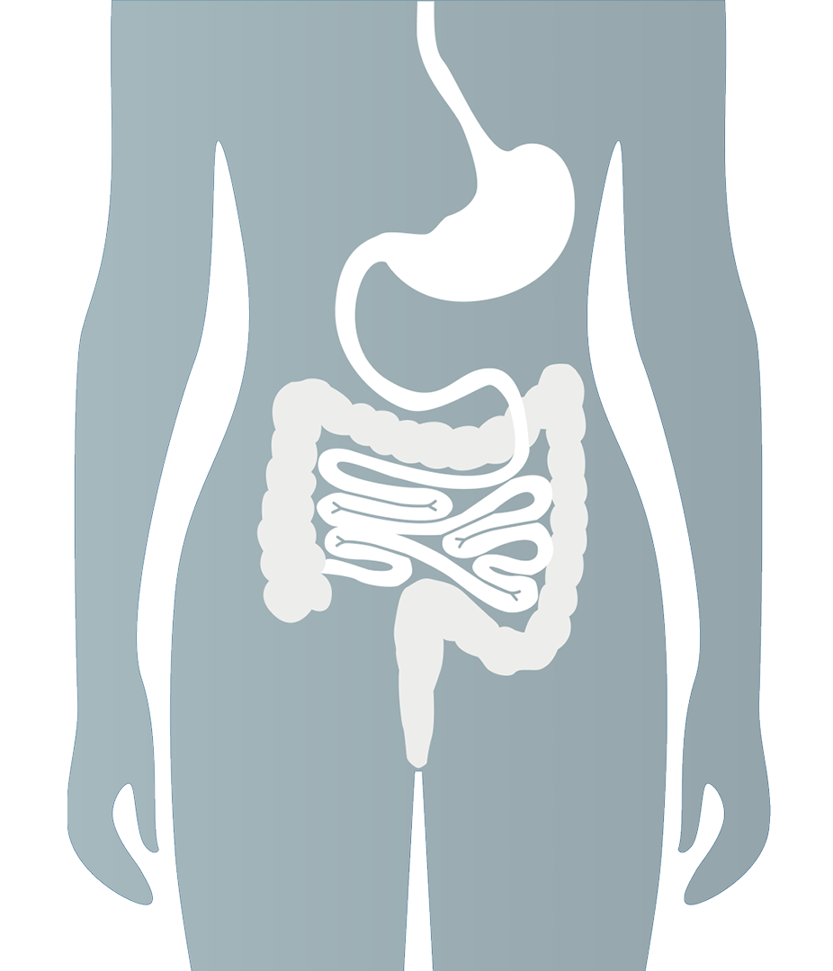



How does glucomannan work in the body?
STOMACH
A gel-like mass forms, leading to:
Increased feeling of fullness
Slower stomach emptying
Reduced appetite
SMALL INTESTINE
The gel continues its journey:
Maintains viscosity
Slows digestion and absorption of carbohydrates and fats
Helps stabilise post-meal blood glucose
LARGE INTESTINE
Glucomannan is partly eaten by gut bacteria, helping produce beneficial compounds that support gut health
IMPORTANT TO ALWAYS CONSUME WITH SUFFICIENT WATER!
Notes:
Let me explain how glucomannan works in the body!
[CLICK] When you consume glucomannan fibre with water, it rapidly absorbs liquid in the stomach and forms a thick, gel-like mass. This is where most of the “swelling” happens. This leads to:
Increased feeling of fullness, in other words, satiety
Slower stomach emptying
Reduced appetite
Which is why it’s often taken before meals for weight management.
[CLICK] After leaving the stomach, the gel continues through the small intestine, where it:
Maintains viscosity
Slows digestion and absorption of carbohydrates and fats
Helps stabilise post-meal blood glucose
So while the main expansion happens in the stomach, its functional effects extend into the small intestine.
[CLICK] In the large intestine (colon), glucomannan is partially fermented (in other words eaten) by gut bacteria, producing beneficial short-chain fatty acids that support gut health.
[CLICK] So why does it matter to consume it with water?
Because glucomannan expands quickly in the stomach, it must always be taken with enough fluid.
Without sufficient water, it could start swelling too early in the throat or esophagus, which is why proper hydration is essential.

Slide 21
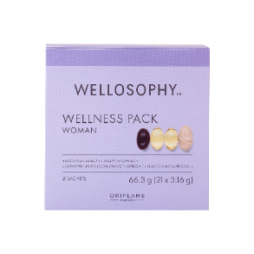
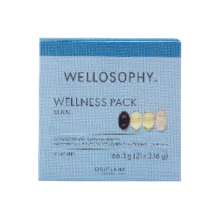
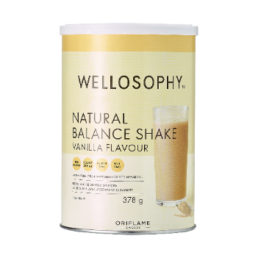
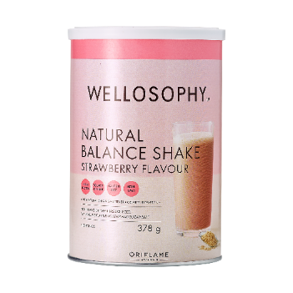
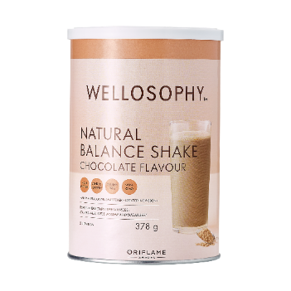
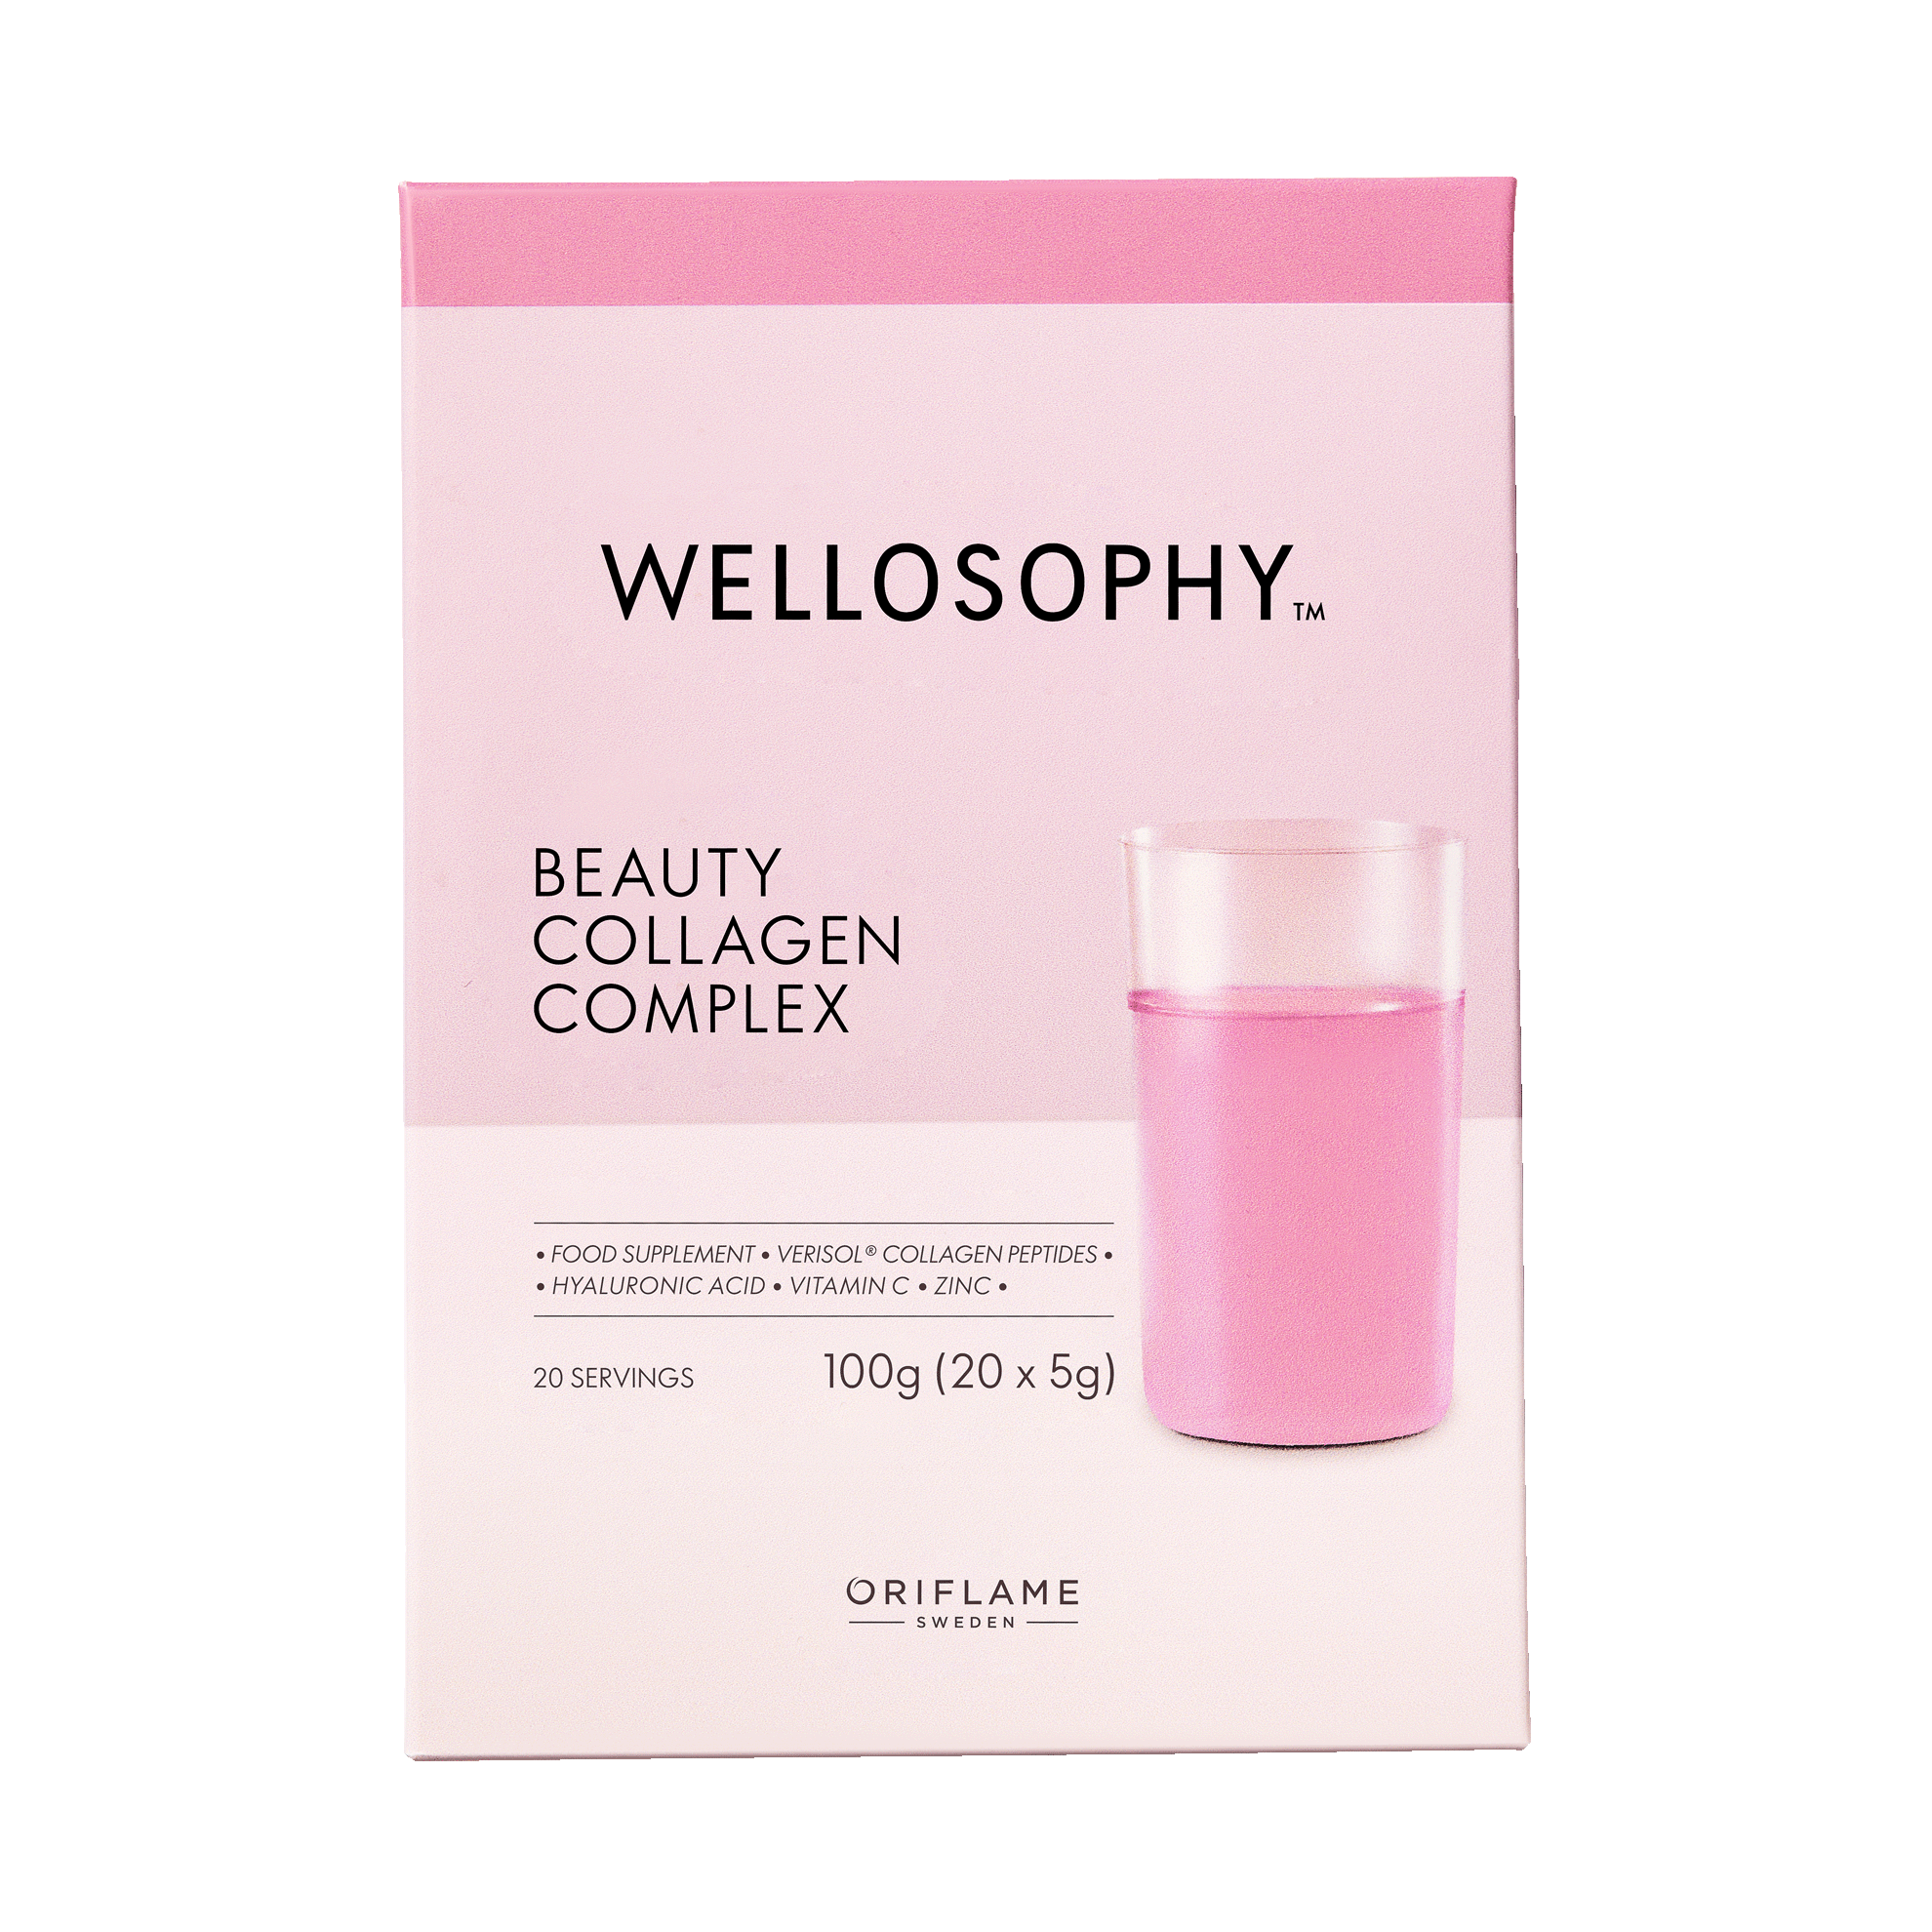
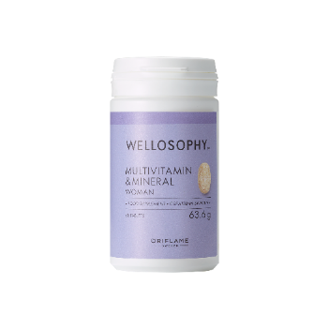
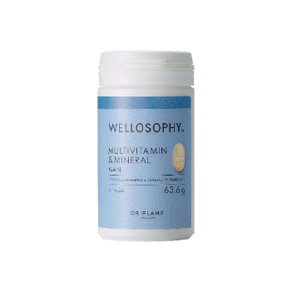
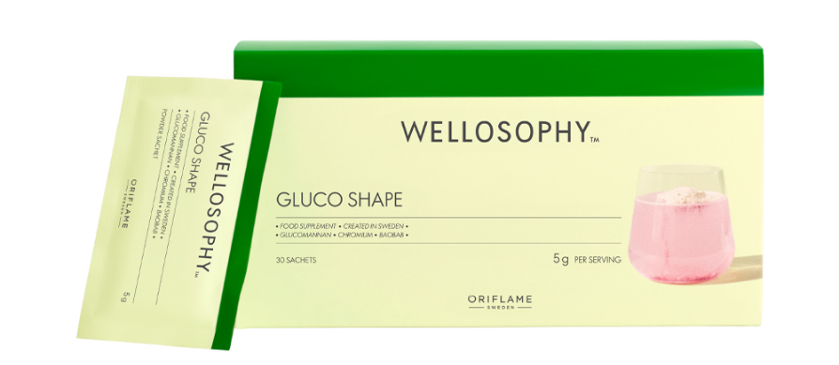
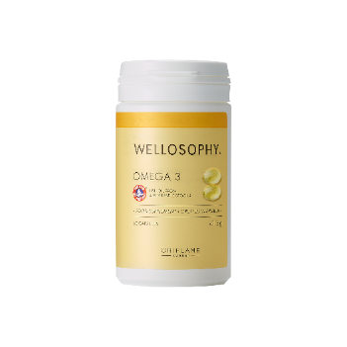
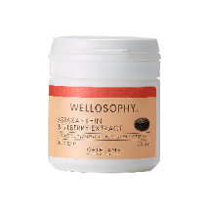
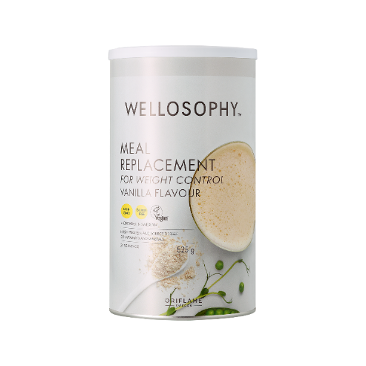
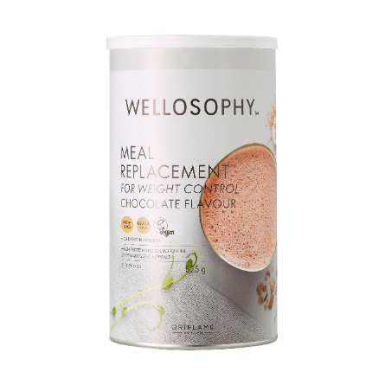
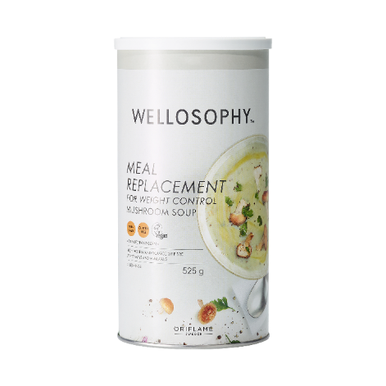
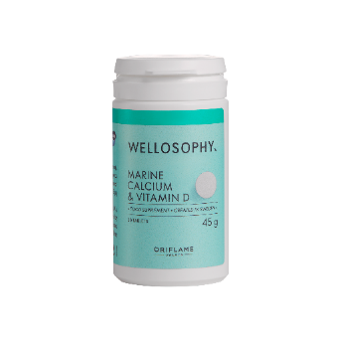
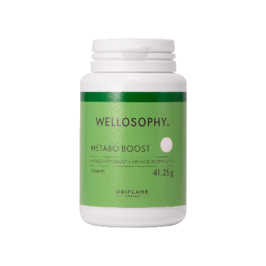
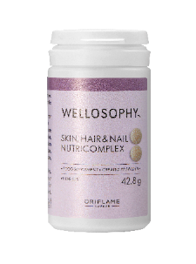
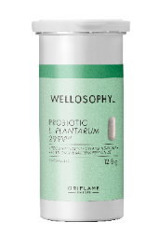
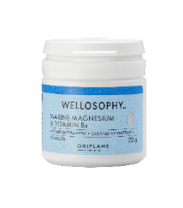
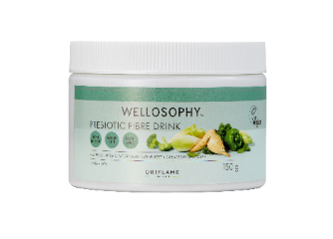
Can be paired with all other Wellosophy products!
It’s advisable not to start consuming several fibre-containing products at once.
Incorporate them gradually in your diet instead.
Notes:
Gluco Shape can be safely combined with other Wellosophy nutritional products without exceeding recommended chromium levels or causing negative side effects.
[CLICK] However, since glucomannan may initially cause mild bloating or gas, it is advisable not to start several fibre-containing products, such as Prebiotic Fibre Drink, Meal Replacement for Weight Control, or Natural Balance Shake, at the same time.
Instead, gradually incorporate them in your diet to allow the body to adapt.

Slide 22

Your two-step daily duo for better habits
Notes:
But the perfect duo of Wellosophy products for better habits is to combine Gluco Shape with Metabo Boost!
Let me tell you why!

Slide 23
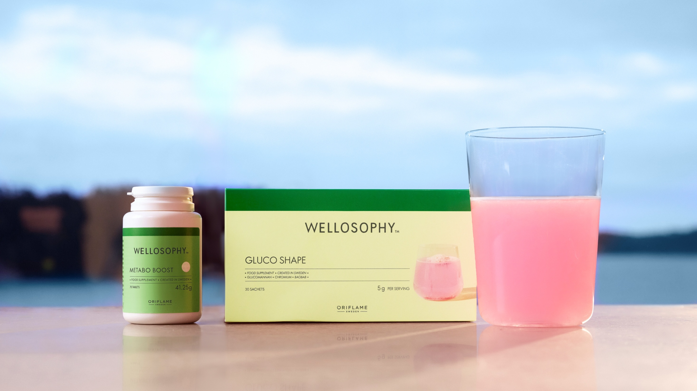
Complement each other!
Perfect combo for Weight Management & Metabolic Health
Gluco Shape helps steady blood sugar and boost fullness.
Metabo Boost smooths cravings and energy dips.
Together, they help you feel
in control of your energy, cravings and choices,
all day long.
Notes:
These products complement each other and is the perfect combo for weight management and metabolic health.
[CLICK] Metabo Boost smooths cravings and energy dips, while Gluco Shape helps steady blood sugar and boost fullness.
[CLICK] And together, they help you feel in control of your energy, cravings and choices, all day long.

Slide 24
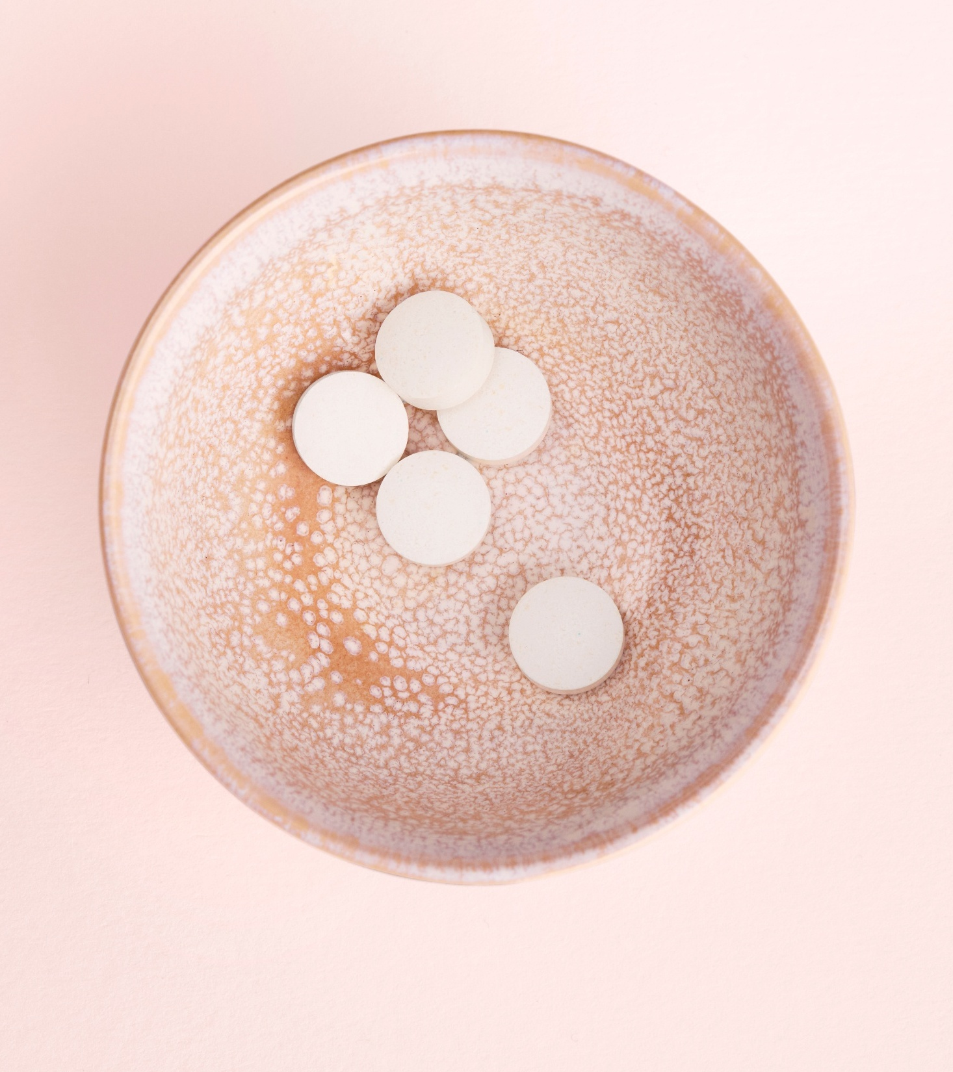


Metabo Boost
Gluco Shape
🔔Your notification system
🔋Your battery stability
Appetite regulation
TCI-1 formula
Metabolism
Zinc and copper
Metabolism & Blood sugar balance
Chromium
Weight loss
Glucomannan
= Smarter signals
= Steady and in control
Notes:
Let me break it down to you more in depth what differs the products and how they can help you accomplish healthier eating habits from different pathways.
[CLICK] Think of your body like a smartphone.
To function well all day, you need two things:
Smart notifications
Stable battery life
Metabo Boost and Gluco Shape support these two different systems.
[CLICK] Metabo Boost is your notification system and helps regulate your internal “notifications.”
It supports appetite regulation through the GLP-1 stimulation from TCI-1 formula in vitro.
Zinc and copper support normal macronutrient metabolism and energy production.
It helps you receive clearer signals about hunger – so you’re not constantly reacting to false alarms like cravings or emotional eating.
[CLICK] Instead of endless snack notifications, you get smarter signals.
[CLICK] Gluco Shape, on the other hand is your battery stability that helps stabilise your “battery usage.”
Chromium supports normal macronutrient metabolism and blood sugar levels.
Glucomannan increases satiety, support healthy digestion and weight loss goals.
It helps reduce sharp energy drops and sudden cravings – like preventing your battery from jumping from 80% to 10% in two hours.
[CLICK] You stay more steady, focused and in control.
*Macronutrients = Nutrients that brings energy (calories) such as protein, carbohydrates, fat.

Slide 25

Notes:
Just watch this! [CLICK]

Slide 26
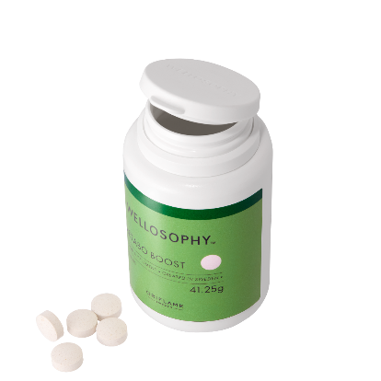
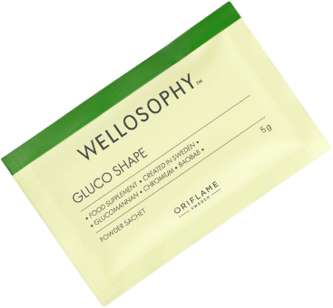
Which product – Gluco Shape or Metabo Boost?
EXERCISE
Scenario 1
“I constantly snack even when I'm not hungry.”
Scenario 2
“I feel tired after meals and crave sugar in the afternoon.”
Scenario 3
“I want support for appetite regulation and metabolism.”
Scenario 4
“I want help with fullness and weight loss goals.”
Scenario 5
“I want support for better eating habits overall.”
Notes:
Let’s do an exercise that will help Beauty Entrepreneurs to know when to recommend each product.
I will present different scenarios and you can guess the product.
[CLICK]Scenario 1
I constantly snack even when I'm not hungry.”
[CLICK]Answer: Metabo Boost
[CLICK]Scenario 2
“I feel tired after meals and crave sugar in the afternoon.”
[CLICK]Answer: Gluco Shape
[CLICK]Scenario 3
“I want support for appetite regulation and metabolism.”
[CLICK]Answer: Metabo Boost
[CLICK]Scenario 4
“I want help with fullness and weight loss goals.”
[CLICK]Answer: Gluco Shape
[CLICK]Scenario 5:
“I want support for better eating habits overall.”
[CLICK]Answer: Both (the duo)

Slide 27
Ingredient match
EXERCISE
INGREDIENTS
Glucomannan
Chromium
TCI-1 formula
Zinc & Copper
BENEFITS
Metabolism support
GLP-1 stimulation (in vitro)
Blood glucose & metabolism
Satiety & weight loss support
Notes:
Here’s another exercise to match different ingredients with the benefit it brings.
Glucomannan - [CLICK]Satiety & weight loss support
Chromium - [CLICK]Blood glucose & metabolism
TCI-1 formula - [CLICK]GLP-1 stimulation (in vitro)
Zinc & Copper - [CLICK]Metabolism support

Slide 28


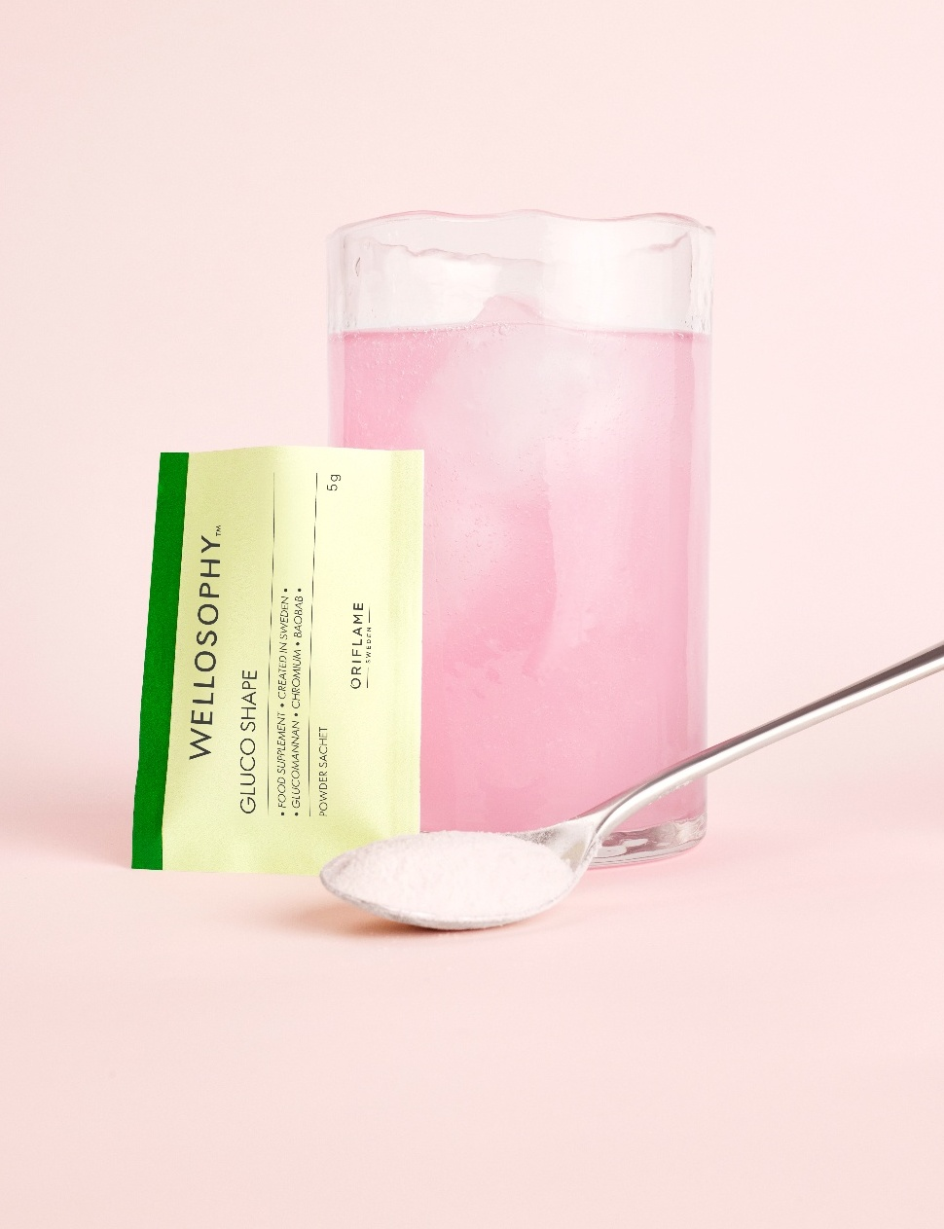
Why buy?
WHO IS IT FOR?
HOW CAN IT HELP?
WHY IS IT SPECIAL?
For adults who struggle with overeating and blood sugar control and want extra support while trying to lose weight.
Ingredients support normal metabolism, glucose balance and fullness – helping you stay consistent and reach your weight loss goals.
A raspberry flavoured unique blend of glucomannan, chromium, and baobab – for simple, daily support for your metabolism and weight journey.
Notes:
So how to sell this product?
Well, let’s first understand why anyone should buy it by discovering who it’s perfect for, how it makes a difference, and what makes it truly unique.
[CLICK] Who is it for?
Gluco Shape is designed for adults (+18 years) who want support with their metabolism, weight management goals and blood sugar control.
It’s especially relevant for those who:
Struggle with overeating or portion control
Experience afternoon slumps or post-meal tiredness
Deal with cravings that derail their progress
Want extra support while trying to lose weight
Feel that their metabolism needs a little help
[CLICK] How will it help – what are the benefits?
Gluco Shape combines ingredients to support normal metabolism, glucose balance and weight loss goals.
This means it can help you:
Support normal nutrient metabolism
Maintain normal blood glucose levels
Increase satiety as part of an energy-restricted diet
Feel more steady and in control throughout the day
When metabolism and glucose balance are supported, it becomes easier to stay consistent with healthy habits.
[CLICK] Why is it special – what makes the product unique?
Gluco Shape is a tasty raspberry flavoured blend that brings together three complementary ingredients in one daily supplement:
Glucomannan – contributes to weight loss in the context of an energy-restricted diet, and promote satiety
Chromium – contributes to normal macronutrient metabolism and maintenance of normal blood glucose levels
Baobab – a fibre- and antioxidant-rich fruit traditionally valued for its nutritional profile
It’s a smart, simple way to support your metabolism and weight journey – so staying on track feels easier, every day.

Slide 29

Combine it with Metabo Boost and you have the perfect solution for metabolic health!
Notes:
Combine it with Metabo Boost and you have the perfect solution for metabolic health!

Slide 30

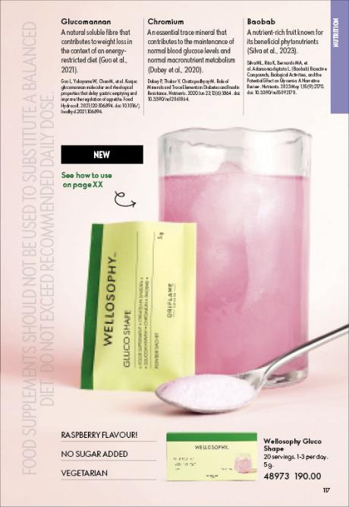


How it’s featured in catalogue
Notes:
In the catalogue we will feature them together as the daily duo for metabolic balance.

Slide 31

How to sell?
ISSUE
SOLUTION
UNIQUENESS
Hey, are you stuck in a cycle of cravings, overeating, and afternoon energy crashes?
React with a 😩 if staying consistent with healthy habits feels harder than it should.
What if you could support both appetite control and metabolic balance every day?
💊 Metabo Boost helps regulate feelings of hunger and appetite.
💗 Gluco Shape supports normal metabolism, glucose balance, and fullness during weight loss.
Together, they help you feel more in control, more balanced, and more consistent.
💊 Metabo Boost combines the proprietary TCI-1 formula (shown in vitro to increase GLP-1 production) with copper and zinc to support metabolism.
💗 Gluco Shape blends glucomannan, chromium, and baobab to support metabolism, blood glucose balance, and satiety.
✔️ Two complementary products.
✔️ One simple daily routine.
✔️ Designed to make healthy habits feel easier.
Interested? Comment DUO below! 💞
😩
86
🤩
70
👍
14
💞
66
💡
16
Notes:
How to sell this two-step daily duo for control & balance in a Social Media chat or in an elevator pitch?
[CLICK] Start with the issue
Are you stuck in a cycle of cravings, overeating, and afternoon energy crashes?
React with a 😩 if staying consistent with healthy habits feels harder than it should.
[CLICK] Present the solution
What if you could support both appetite control and metabolic balance every day?
💊 Metabo Boost helps regulate feelings of hunger and appetite.
💗 Gluco Shape supports normal metabolism, glucose balance, and fullness during weight loss.
Together, they help you feel more in control, more balanced, and more consistent.
[CLICK] Highlight the uniqueness
Metabo Boost combines the proprietary TCI-1 formula (shown in vitro to increase GLP-1 production) with copper and zinc to support metabolism.
Gluco Shape blends glucomannan, chromium, and baobab to support metabolism, blood glucose balance, and satiety.
✔️Two complementary products.
✔️One simple daily routine.
✔️Designed to make healthy habits feel easier.
Interested? Comment DUO below! 💞

Slide 32
Frequently Asked Questions
Is Wellosophy Gluco Shape suitable for long-term use?
Wellosophy Gluco Shape should be used as part of a balanced diet and healthy lifestyle. If taken as recommended, it’s suitable for long-term use.
Why is glucose balance important?
Supporting normal blood glucose levels is increasingly recognised as an important part of metabolic health, weight management and everyday wellbeing.
Who can take Wellosophy Gluco Shape?
Wellosophy Gluco Shape is suitable for adults who want to support their appetite control, weight goals, and balanced blood sugar as part of a healthy lifestyle.
Who should not take Wellosophy Gluco Shape?
Wellosophy Gluco Shape is not intended for children, pregnant or breastfeeding women, or people with medical conditions without professional medical advice.
Notes:
Let’s go through some commonly asked questions.
[CLICK] Q: Is Wellosophy Gluco Shape suitable for long-term use?
[CLICK] A: Wellosophy Gluco Shape should be used as part of a balanced diet and healthy lifestyle. If taken as recommended, it’s suitable for long-term use.
[CLICK] Q: Why is glucose balance important?
[CLICK] A: Supporting normal blood glucose levels is increasingly recognised as an important part of metabolic health, weight management and everyday wellbeing.
[CLICK] Q: Who can take Wellosophy Gluco Shape?
[CLICK] A: Wellosophy Gluco Shape is suitable for adults who want to support their appetite control, weight goals, and balanced blood sugar as part of a healthy lifestyle.
[CLICK] Q: Who should not take Wellosophy Gluco Shape?
[CLICK] A: Wellosophy Gluco Shape is not intended for children, pregnant or breastfeeding women, or people with medical conditions without professional medical advice.

Slide 33


Call to Action
1
2
Compra os produtos
Começa a planear o desafio
Hoje
Amanhã
Notes:
Now we’ve both learned and experienced Gluco Shape.
So it’s time with a Call to action!
[CLICK] First thing is to buy both Gluco Shape and Metabo Boost.
[CLICK] Second thing is to start planning for a Craving Control Challenge.
It’s an activity you can run for 30 days in Social Media. This is to create a movement and raise interest in the products for potential customers.
I will provide you with all instructions after this session.

Slide 34

Inclui Gluco Shape na tua rotina de beleza!
Notes:
With that said, make Gluco Shape part of your Beauty Routine!

Slide 35
Thank you
Contact
Notes:
Thank you for attending this training!
Hope it has equipped you with confidence in how it works and how it can be recommended to others!

